Slide 1


Neel Patel
10/19/2024

Slide 2

Outline
Executive Summary
Introduction
Methodology
Results
Conclusion
Appendix

Slide 3
Executive Summary
Summary of methodologies
Data Collection
Data Wrangling
EDA with Data Visualization
EDA with SQL
Building a Dashboard with Plotly Dash
Predictive Analysis
Summary of all results
Exploratory Data Analysis Results
Interactive Analytics Demo
Predictive Analysis Results

Slide 4
Introduction
Project background and context
The era of commercial space travel has arrived, with companies like SpaceX leading the way in making space exploration more affordable. SpaceX's Falcon 9 rocket is priced at $62 million per launch, significantly lower than competitors, whose costs often exceed $165 million. This cost efficiency is largely due to SpaceX's ability to reuse the first stage of the Falcon 9.
This project aims to predict the likelihood of a successful landing for the Falcon 9's first stage. Understanding this outcome is essential for determining launch costs and for potential competitors looking to bid against SpaceX.
Problems you want to find answers
What correlations exist between rocket variables and the successful landing rate of the Falcon 9's first stage?
What conditions optimize the chances of achieving the highest successful landing rate?

Slide 5

Section 1

Slide 6
Methodology
Executive Summary
Data collection methodology:
SpaceX API and Web Scraping from Wikipedia
Perform data wrangling
Convert the outcomes into training groups with boosters landed
Perform exploratory data analysis (EDA) using visualization and SQL
Perform interactive visual analytics using Folium and Plotly Dash
Perform predictive analysis using classification models
Find best Hyperparameter for SVM, Classification Trees and Logistic Regression

Slide 7
Data Collection
The data collection process involves gathering information through two primary methods: API requests to the SpaceX API and web scraping from a Wikipedia page containing launch records for SpaceX, Falcon 9, and Falcon Heavy.
Request Data from SpaceX API
Get HTML Response from Wiki Page
Extract Data using Beautiful Soup
Receive Data from API in JSON
Normalize Data into CSV
Normalize Data into CSV

Slide 8
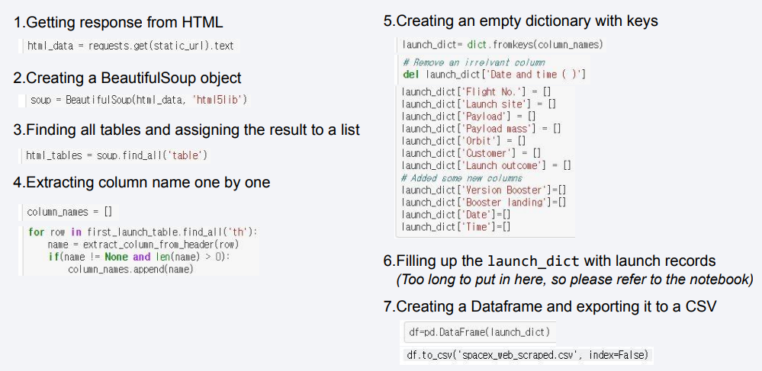
Data Collection – SpaceX API

Slide 9
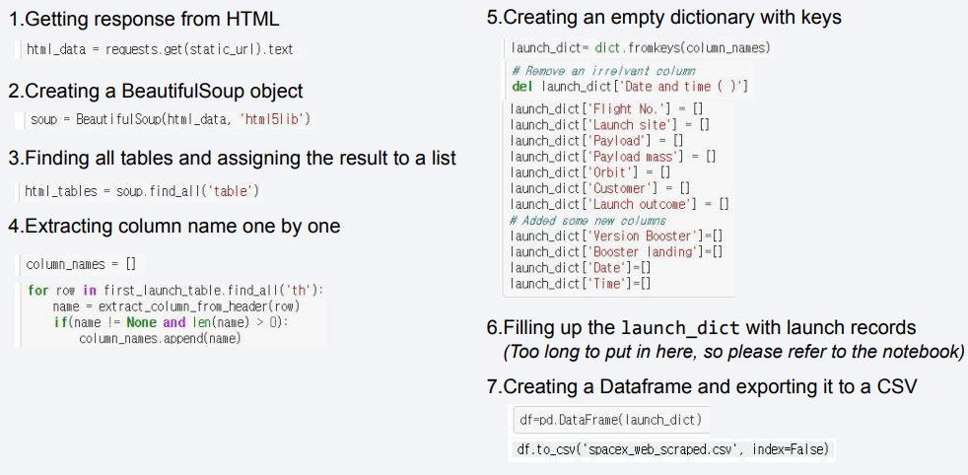
Data Collection - Scraping

Slide 10
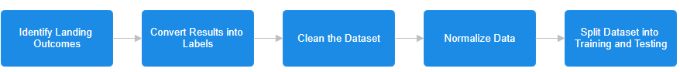
Data Wrangling
Categorize each landing attempt based on the results:
True Ocean: Successfully landed in the ocean.
False Ocean: Failed to land in the ocean.
True RTLS: Successfully landed on the ground pad.
False RTLS: Failed to land on the ground pad.
True ASDS: Successfully landed on the drone ship.
False ASDS: Failed to land on the drone ship.
Convert Landing Results into Training Labels
Assign binary labels for training:
1 = Successful Landing
0 = Failed Landing
Clean the Dataset
Normalize Data
Split Dataset

Slide 11
EDA with Data Visualization
Summary of Plotted Charts
1. Scatter Charts
Flight Number vs. Launch Site
Payload vs. Launch Site
Flight Number vs. Orbit Type
Payload vs. Orbit Type
Purpose: Scatter charts were used to visualize the correlation between two numerical variables. They provide insights into how one variable may affect another and reveal patterns or trends within large datasets. These charts help in understanding relationships, such as how different launch sites or orbit types influence flight numbers and payloads.
2. Bar Chart
Orbit Type vs. Success Rate
Purpose: A bar chart was employed to compare success rates across different orbit types. It allows for easy visualization and comparison of discrete categories at a glance. By representing one axis with categories (orbit types) and the other with success rates, this chart effectively illustrates the relationship between the type of orbit and the associated success rate of launches.
3. Line Chart
Year vs. Success Rate
Purpose: A line chart was utilized to show the trend of success rates over the years. This chart effectively conveys data variables and trends, making it easier to observe changes over time. It helps in predicting potential future outcomes based on historical data, allowing for a clearer understanding of how launch success has evolved.

Slide 12
EDA with SQL
Task 1: Display unique launch sites
Query: SELECT DISTINCT "Launch_Site" FROM SPACEXTABLE;
Task 2: Display 5 records where launch sites begin with 'CCA'
Query: SELECT * FROM "SPACEXTABLE" WHERE "Launch_Site" LIKE 'CCA%' LIMIT 5;
Task 3: Display total payload mass carried by NASA (CRS)
Query: SELECT SUM("Payload_Mass_kg") AS Total_Payload_Mass FROM SPACEXTABLE WHERE "Launch_Provider" = 'NASA (CRS)';
Task 4: Display average payload mass for booster version F9 v1.1
Query: SELECT AVG("Payload_Mass_kg") AS Average_Payload_Mass FROM SPACEXTABLE WHERE "Booster_Version" = 'F9 v1.1';
Task 5: List the date of the first successful landing outcome on ground pad
Query: SELECT MIN("Date") AS First_Successful_Landing_Date FROM SPACEXTABLE WHERE "Landing_Outcome" = 'Success (ground pad)';
Task 6: List booster names with successful drone ship landings and payload mass > 4000 but < 6000
Query: SELECT DISTINCT "Booster_Version" FROM SPACEXTABLE WHERE "Landing_Outcome" = 'Success (drone ship)' AND "Payload_Mass_kg" > 4000 AND "Payload_Mass_kg" < 6000;
Task 7: Count of successful and failure mission outcomes
Query: SELECT "Landing_Outcome", COUNT(*) AS Total_Count FROM SPACEXTABLE GROUP BY "Landing_Outcome";
Task 8: List booster versions with maximum payload mass using subquery
Query: SELECT "Booster_Version" FROM SPACEXTABLE WHERE "Payload_Mass_kg" = (SELECT MAX("Payload_Mass_kg") FROM SPACEXTABLE);
Task 9: Display month names, failure landing outcomes in drone ship, booster versions, and launch site for 2015
Task 10: Rank landing outcomes count between 2010-06-04 and 2017-03-20
Query: SELECT "Landing_Outcome", COUNT(*) AS Total_Count FROM SPACEXTABLE WHERE "Date" BETWEEN '2010-06-04' AND '2017-03-20' GROUP BY "Landing_Outcome" ORDER BY Total_Count DESC;

Slide 13
Build an Interactive Map with Folium
Map Objects Created with Folium
Markers for Launch Sites:
Indicate all launch sites on the map for easy identification.
Markers for Launch Outcomes:
Differentiate between successful and failed launches at each site, allowing quick assessment of performance.
Lines Showing Distances:
Visualize distances from launch sites to nearby infrastructure (railways, highways, coastlines) for spatial analysis.
Rationale for Adding Objects
Geographical Pattern Analysis:
Proximity to Railways and Highways: Assess logistical advantages for transportation.
Proximity to Coastline: Consider safety and operational factors.
Distance from Cities: Ensure compliance with safety regulations and minimize risks.
These objects facilitate a comprehensive understanding of launch site operations and their contextual relationships with key geographical features.

Slide 14
Build a Dashboard with Plotly Dash
Plots and Interactions in the Dashboard
Pie Chart:
Purpose: Displays the total successful launches by launch sites.
Interactivity: Users can select to view the overall successful landing distribution or focus on the success rate of individual launch sites.
Scatter Chart:
Purpose: Illustrates the relationship between launch outcomes and payload mass (in kg) for different boosters.
Inputs:
Selection for all sites or an individual site.
A slider to adjust the payload mass between 0 and 10,000 kg.
Benefits: Helps analyze how success rates correlate with launch locations, payload mass, and booster categories.
Rationale for Adding Plots and Interactions
Insightful Analysis: The pie chart provides a clear overview of success rates across sites, while the scatter chart enables detailed examination of factors affecting launch outcomes.
User Engagement: Interactive elements allow users to explore data dynamically, facilitating deeper insights into launch performance and operational trends.

Slide 15
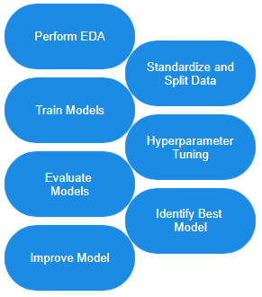
Predictive Analysis (Classification)
Model Development Process
Exploratory Data Analysis (EDA)
Analyze data distributions and correlations.
Create class labels (1 for success, 0 for failure).
Data Preparation
Standardize Data: Normalize features.
Split Data: Divide into training and test sets.
Model Selection and Hyperparameter Tuning
Test models: SVM, Classification Trees, Logistic Regression.
Optimize hyperparameters using Grid or Random Search.
Model Evaluation
Evaluate performance on test data.
Compare accuracy, precision, recall, and F1-score.
Model Improvement
Iterate improvements based on performance metrics.

Slide 16
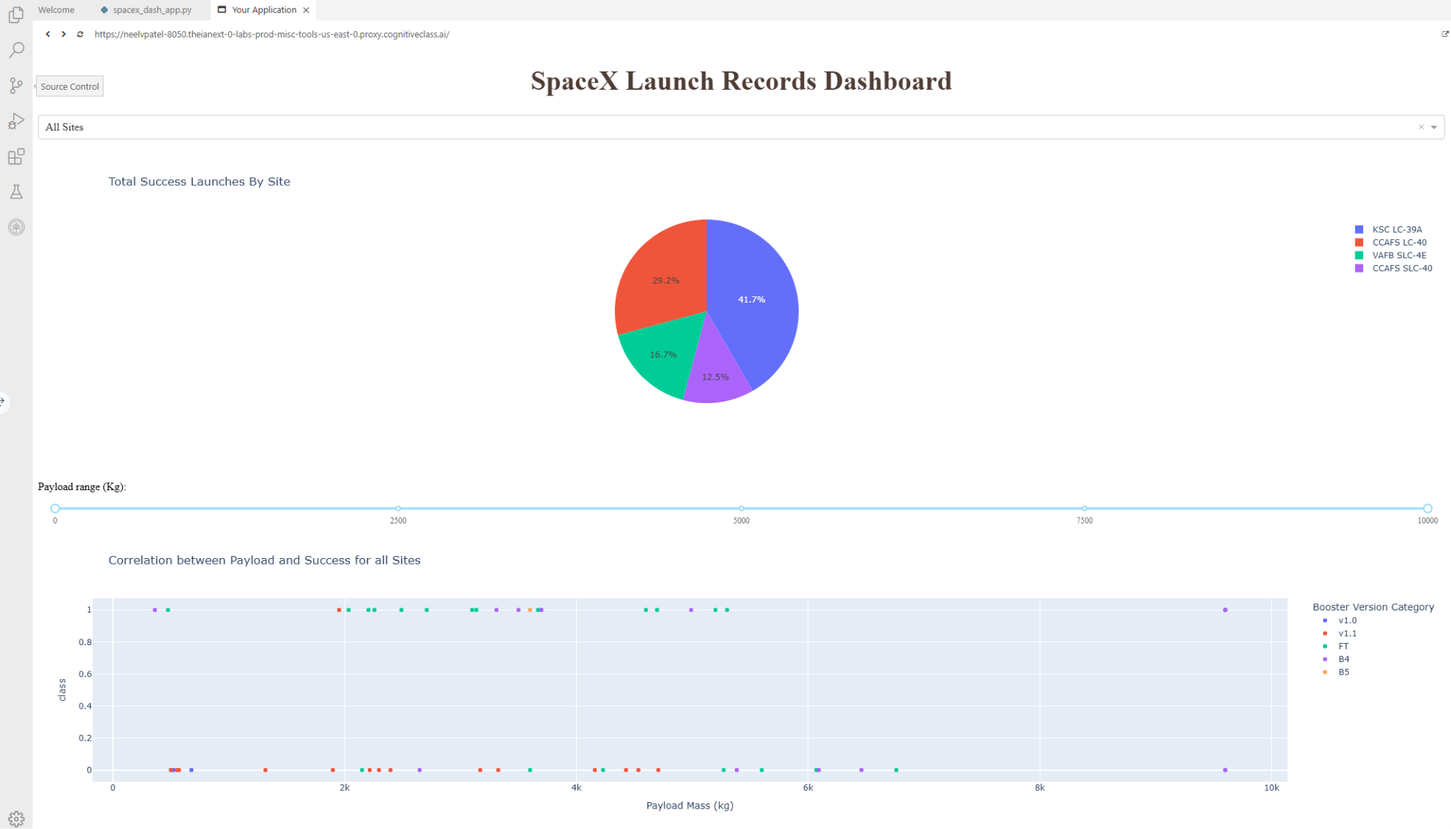
Results

Slide 17

Section 2

Slide 18
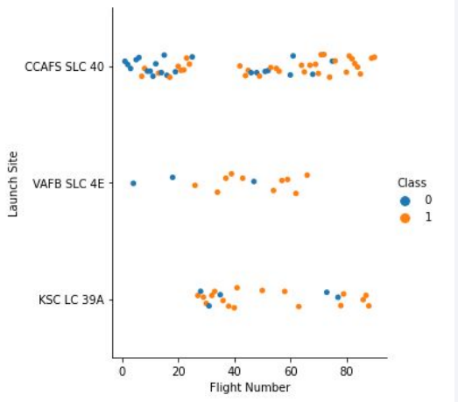
Flight Number vs. Launch Site
This scatter plot shows Flight Number versus Launch Site.
Class 0 (blue): Represents unsuccessful launches.
Class 1 (orange): Represents successful launches.
The plot illustrates that as flight numbers increase, the success rate also improves, especially after the 20th flight, marking a significant improvement in launch success. ​

Slide 19
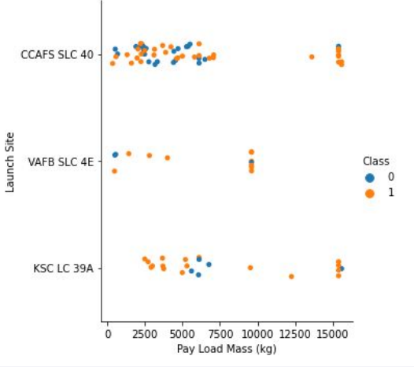
Payload vs. Launch Site
Here's a scatter plot of Payload versus Launch Site:
Class 0 (blue): Represents unsuccessful launches.
Class 1 (orange): Represents successful launches.
This plot suggests that while larger payload masses might have a higher success rate, it's challenging to draw definitive conclusions, as there isn't a clear pattern linking payload mass directly to successful launches.

Slide 20
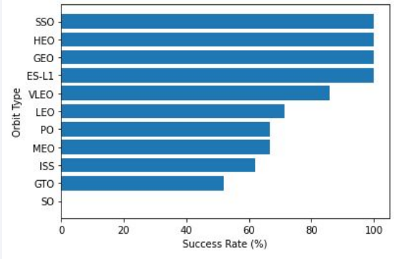
Success Rate vs. Orbit Type
Orbit types SSO, HEO, GEO, and ES-L1 show the highest success rates at 100%.
In contrast, the GTO orbit type has a success rate of only 50%, making it the lowest, aside from the SO type, which failed in its only attempt.

Slide 21
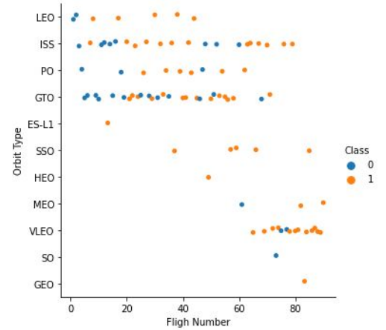
Flight Number vs. Orbit Type
Class 0 (blue) indicates unsuccessful launches, while Class 1 (orange) represents successful launches.
The scatter plot suggests that, in most cases, launch success correlates with the flight number—as the flight number increases, the success rate tends to improve.
However, for GTO orbit, there appears to be no clear relationship between flight numbers and the success rate.
SpaceX initially focused on LEO with moderate success but has increasingly relied on VLEO for recent launches, where the success rate is notably high.

Slide 22
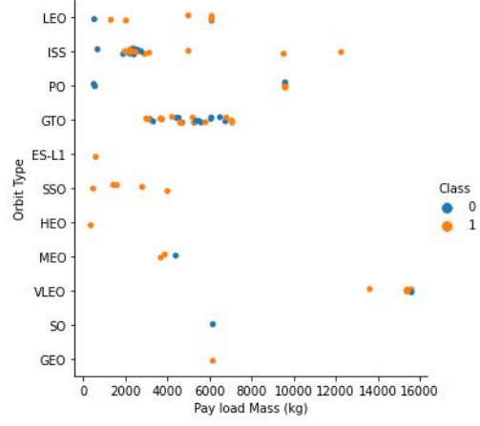
Payload vs. Orbit Type
Class 0 (blue) shows unsuccessful launches, while Class 1 (orange) indicates successful launches.
The scatter plot reveals that heavy payloads are generally associated with higher success rates, particularly in LEO and ISS orbits.
In contrast, for GTO, it is difficult to distinguish between successful and unsuccessful landings as the data points are clustered closely together, showing no clear pattern.

Slide 23
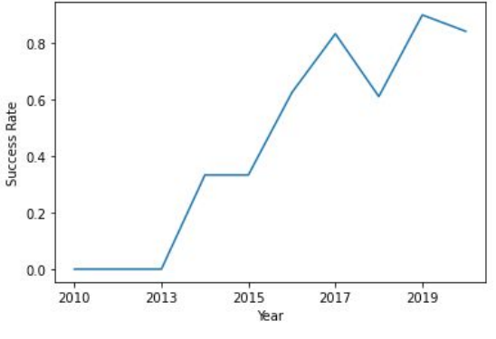
Launch Success Yearly Trend
Since 2013, the success rate steadily increased up until 2017.
In 2018, there was a slight decline in the rate.
Currently, the success rate is approximately 80%.

Slide 24
All Launch Site Names
The SQL DISTINCT clause was used to retrieve only unique values from the Launch_Site column in the SpaceX table.
There are four unique launch sites:
CCAFS LC-40
CCAFS SLC-40
KSC LC-39A
VAFB SLC-4E
The Query:
SELECT DISTINCT LAUNCH_SITE
FROM SPACEXTBL;

Slide 25
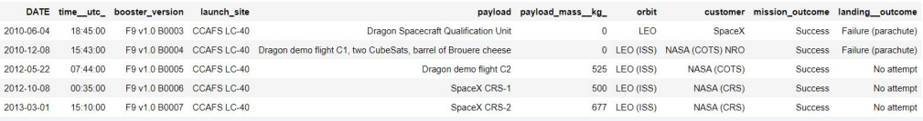
Launch Site Names Begin with 'CCA'
The SQL query retrieves records from the SpaceX table, displaying only five records due to the inclusion of the LIMIT 5 clause. This limit ensures that the result set does not exceed five entries.
To filter for launch site names that start with CCA, the query employs the LIKE operator in conjunction with the percent sign (%). This allows for matching any characters that may follow the CCA prefix in the Launch_Site field.
The Query:
SELECT * FROM SPACEXTBL
WHERE LAUNCH_SITE LIKE ‘CCA%’
LIMIT 5

Slide 26
Total Payload Mass
The SQL query utilizes the SUM() function to compute the total mass of payloads (measured in kilograms) carried by boosters for NASA. The WHERE clause filters the dataset to ensure that only records where the customer is 'NASA (CRS)' are included in the calculation.
The resulting total payload mass is 45,596 kg.
The Query:
SELECT SUM(PAYLOAD_MASS_KG_) AS total_payload_mass_kg
FROM SPACEXTBL
WHERE CUSTOMER = ‘NASA (CRS)’

Slide 27
Average Payload Mass by F9 v1.1
The SQL query employs the AVG() function to determine the average payload mass (in kilograms) for launches using the F9 v1.1 booster version. The WHERE clause filters the dataset to include only those records where the booster version is specified as 'F9 v1.1'.
The resulting average payload mass is 2,928 kg.
The Query:
SELECT AVG(PAYLOAD_MASS_KG_) AS avg_payload_mass_kg
FROM SPACEXTBL
WHERE BOOSTER_VERSION = ‘F9 v1.1’

Slide 28
First Successful Ground Landing Date
The SQL query utilizes the MIN() function to identify the earliest date in the DATE column. The WHERE clause filters the dataset to include only those records where the landing outcome is classified as 'Success (ground pad)'.
The resulting date of the first successful landing on a ground pad is December 22, 2015.
The Query:
SELECT MIN(DATE) AS first_successful_landing_date
FROM SPACEXTBL
WHERE LANDING_OUTCOME = ‘Success (ground pad)’

Slide 29
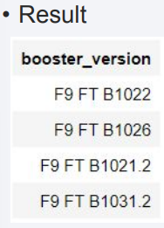
Successful Drone Ship Landing with Payload between 4000 and 6000
The SQL query retrieves the names of boosters from the dataset, applying filters in the WHERE clause to ensure that only records with a landing outcome of 'Success (drone ship)' are included. Additionally, it uses the AND operator to further filter the results, displaying only those records where the payload mass is between 4,000 kg and 6,000 kg.
The Query:
SELECT BOOSTER_VERSION
FROM SPACEXTBL
WHERE LANDING_OUTCOME = ‘Success (drone ship)’ and (PAYLOAD_MASS_KG_ BETWEEN 4000 AND 6000)

Slide 30
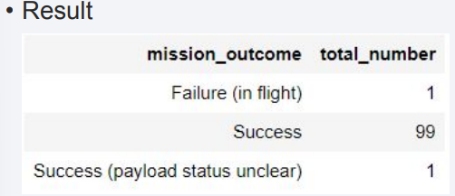
Total Number of Successful and Failure Mission Outcomes
The SQL query uses the COUNT() function to tally the total number of missions in the dataset. By employing the GROUP BY statement, the query groups the results based on the Mission_outcome field, allowing for a summary of the total count for each outcome category (success and failure).
According to the results, SpaceX has successfully completed nearly 99% of its missions.
The Query:
SELECT MISSION_OUTCOME,
COUNT(*) AS total_number
FROM SPACEXTBL
GROUP BY MISSION_OUTCOME

Slide 31
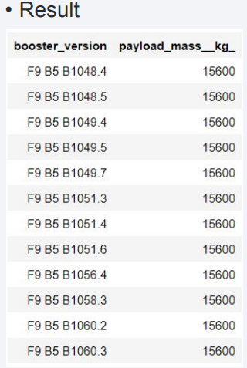
Boosters Carried Maximum Payload
The SQL query utilizes a subquery to first determine the maximum payload mass using the MAX() function. The outer query then filters the dataset to find the names of the boosters that have achieved this maximum payload mass.
According to the results, the booster version F9 B5 B10xx.x carried the maximum payload.
The Query:
SELECT DISTINCT BOOSTER_VERSION, PAYLOAD_MASS_KG_
FROM SPACEXTBL
WHERE PAYLOAD_MASS_KG = (
SELECT MAX(PAYLOAD_MASS_KG_)
FROM SPACEXTBL)

Slide 32
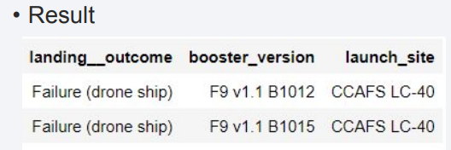
2015 Launch Records
The SQL query filters the dataset to retrieve records where the Landing_outcome is 'Failure (drone ship)'. The WHERE clause also includes an additional condition to specify that the records must be from the year 2015. The AND operator is used to combine these conditions.
According to the results, there were two landing failures on drone ships in 2015.
The Query:
SELECT LANDING_OUTCOME,
BOOSTER_VERSION,
LAUNCH_SITE
FROM SPACEXTBL
WHERE LANDING_OUTCOME = ‘Failure (drone ship)’ AND YEAR(DATE) = ‘2015’

Slide 33
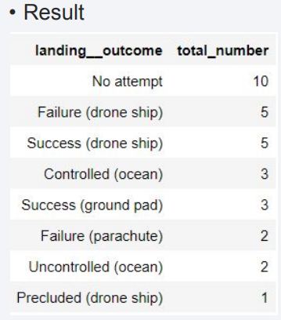
Rank Landing Outcomes Between 2010-06-04 and 2017-03-20
The SQL query filters the dataset using the WHERE clause to include only records where the date falls between June 4, 2010, and March 20, 2017. The query then utilizes the COUNT() function to tally the occurrences of each landing outcome. The GROUP BY clause groups the results by the Landing_outcome, while the ORDER BY clause sorts the counts in descending order using the DESC keyword.
According to the results, the number of successes and failures between June 4, 2010, and March 20, 2017, was similar.
The Query:
SELECT LANDING_OUTCOME,
COUNT(LANDING_OUTCOME) AS total_number
FROM SPACEXTBL
WHERE DATE BETWEEN ‘2010-06-04’ AND ‘2017-03-20’
GROUP BY LANDING_OUTCOME
ORDER BY total_number DESC

Slide 34

Section 3

Slide 35
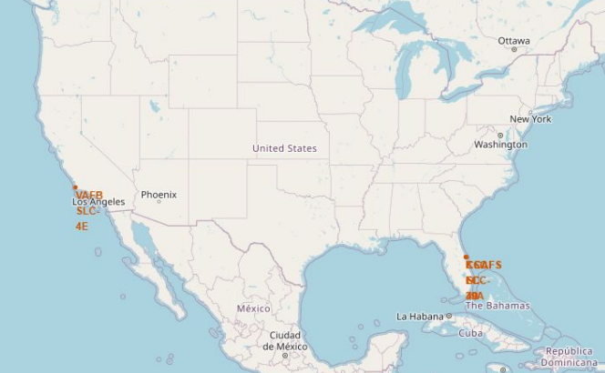

Launch Site Locations
Launch Sites Overview: The left map displays all SpaceX launch sites, while the right map confirms that all these sites are located within the United States. This highlights SpaceX's operational focus on domestic launches.
Geographic Distribution: Both maps illustrate that all launch sites are situated near the coast. This coastal positioning is significant for several reasons:
Safety: Launching from coastal areas reduces the risk to populated regions in the event of a launch failure, as rockets can ascend over open water.
Range: Coastal sites allow for a broader range of launch trajectories, enabling missions to various orbits and destinations without overflying land.

Slide 36
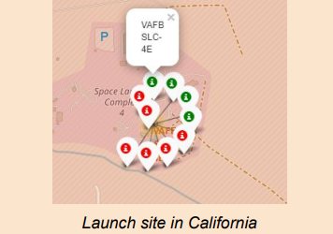
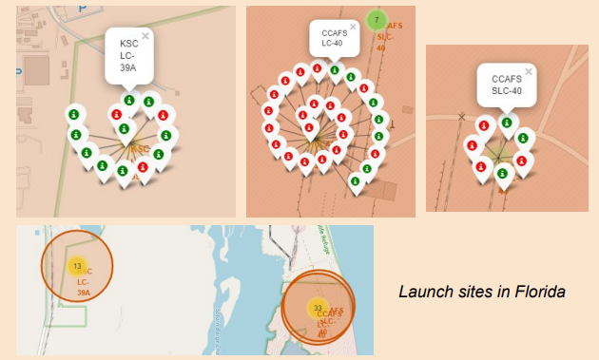
<Folium Map Screenshot 2>
Successful Landing is in Green
Failed Landing is in Red

Slide 37

Section 4

Slide 38
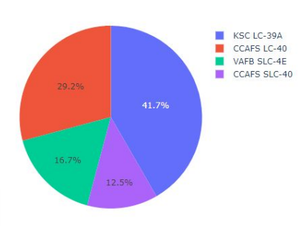
Total Success Launches By all sites
Explanation of Important Elements and Findings:
KSLC-39A Success: The screenshot shows that KSLC-39A has the highest number of successful launches among all SpaceX sites, indicating its reliability.
VAFB SLC-4E Performance: VAFB SLC-4E records the fewest successful launches, which may be due to:
Small Data Sample: Limited launches can skew results.
Geographic Challenges: Being the only California site, VAFB may face unique difficulties, such as weather and airspace restrictions, that affect launch success compared to east coast sites.
Future Implications: Analyzing launch site performance can guide future operational strategies to enhance success rates.

Slide 39
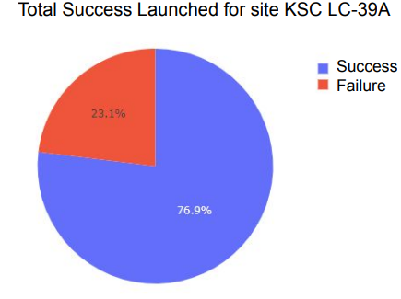
Launch Site with Best Launch Success Ratio
Explanation of Important Elements and Findings:
KSLC-39A Performance: The screenshot indicates that KSLC-39A has the highest landing success rate among SpaceX launch sites, achieving 10 successful landings (76.9%) and 3 failures (23.1%).
Success Rate Implications: This high success rate highlights KSLC-39A's reliability as a launch site, suggesting effective operational practices and favorable conditions contributing to successful landings.

Slide 40
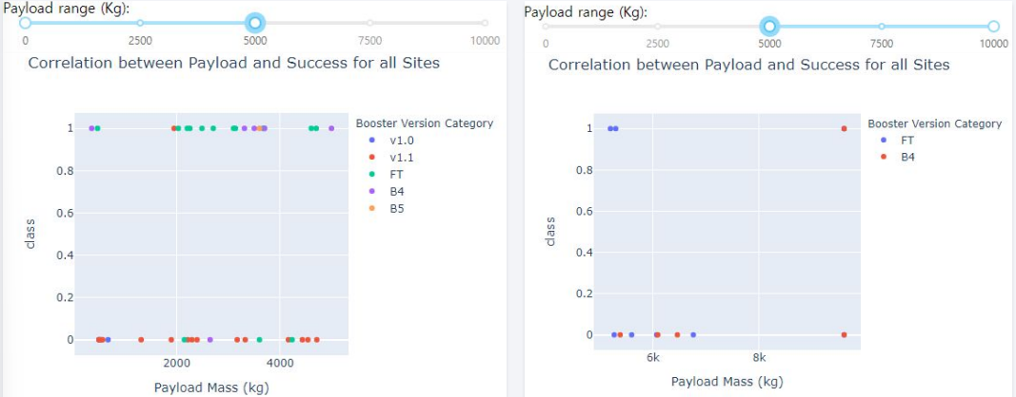
Payload and Launch Outcome Scatter Plot
Launch Success Rates by Payload Weight: The figures indicate that the launch success rate (class 1) is significantly higher for low-weight payloads (0-5000 kg) compared to heavy-weight payloads (5000-10000 kg).

Slide 41

Section 5

Slide 42
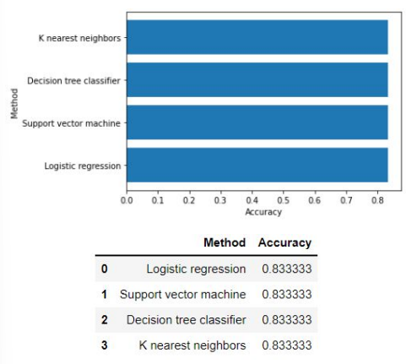
Classification Accuracy
Findings: All models achieved an accuracy of 83.33% on the test set. However, the small test size of 18 samples may not provide a reliable measure of model performance.
Conclusion: To accurately determine the optimal model, a larger dataset is needed.

Slide 43
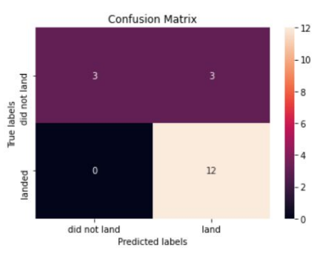
Confusion Matrix
The confusion matrix for the best-performing model, which is identical across all models due to their equal performance, reveals the following outcomes:
True Positives (TP): 12 successful landings were correctly predicted.
True Negatives (TN): 0 failed landings were correctly predicted (indicating no failures were identified correctly).
False Positives (FP): 3 instances were incorrectly predicted as successful landings when they were actually failures.
False Negatives (FN): 3 failed landings were incorrectly predicted as successful landings.
Summary:
The models effectively predict successful landings, as evidenced by the high number of true positives.
However, the presence of false positives indicates that the models struggle with identifying failed landings.
Overall, while the models demonstrate strong performance in predicting successful outcomes, there is a need for improvement in accurately detecting failures.

Slide 44
Conclusions
Model Accuracy and Data Needs: Despite all models achieving an accuracy of 83.33%, the small dataset size (18 samples) limits the reliability of these results. More comprehensive data is needed to accurately assess and determine the optimal model.
Challenges with Failure Predictions: The presence of false positives (3 predictions of successful landings that were actually failures) indicates a limitation in the models' ability to accurately detect failed landings. This suggests that further refinement may be needed to enhance the models' performance in this area.
Increasing Success Rate: As the number of flights has increased, the overall success rate has improved, now exceeding 80%. This trend reflects enhancements in launch technology and operational procedures.
KSLC-39A Performance: KSLC-39A stands out as the site with the highest number of successful launches and the best success rate, demonstrating its effectiveness as a launch facility.
Payload Weight Impact: The success rate for low-weight payloads (0-5000 kg) is higher than that for heavy-weight payloads (5000-10000 kg), suggesting that lighter payloads may face fewer challenges during launch.

Slide 45


